Slide 1
CS 35L – Section 1
11/13/2013
Zhanyong Wang (Jerry)
zhanyongwang@ucla.edu
Office Hour:
9:00-11:00 Tuesday
BH 2432

Slide 2
Processor Modes
Operating modes that place restrictions on the type of operations that can be performed by running processes
  User mode: restricted access to system resources
  Kernel/Supervisor mode: unrestricted access
Hardware contains a mode-bit, e.g. 0 means kernel mode, 1 means user mode

Slide 3
User Mode vs. Kernel Mode
User mode
  CPU restricted to unprivileged instructions and a specified area of memory
  For untrusted user code
Supervisor mode
  CPU is unrestricted, can use all instructions and access all areas of memory
  For trusted kernel/OS code

Slide 4
Why Dual-Mode Operation?
System resources (memory, CPU, I/O devices etc.) are shared among processes
OS must ensure:
  Protection
    an incorrect/malicious program cannot cause damage to other processes or the system as a whole
  Fairness
    Make sure processes have a fair use of devices and the CPU

Slide 5
How to Achieve Protection and Fairness
Some instructions are privileged and can only be executed by trusted code to ensure:
  I/O Protection
    Prevent users from performing illegal I/O operations
  Memory Protection
    Prevent users from accessing illegal memory and modifying kernel code and data structures
  CPU Protection
    Prevent a user from using the CPU for too long

Slide 6
Which Code is Trusted?
The kernel is the core of an operating system software which executes in supervisor mode
The kernel code is trusted
  implements protection mechanisms
  Mechanisms cannot be changed through actions of untrusted software in user space

Slide 7
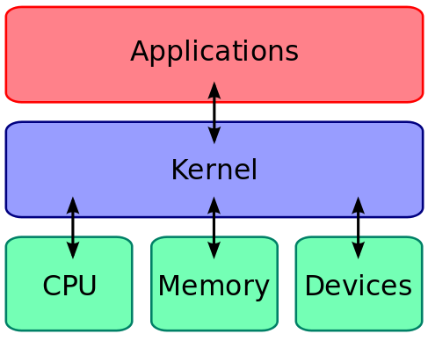
What About User Processes?
The kernel executes privileged operations on behalf of untrusted user processes
Kernel is the interface between hardware and software

Slide 8
System Calls
Special type of function that:
  Changes the CPU’s mode from user mode to kernel mode to enable more capabilities
  Used by user-level processes to invoke OS functions
  is a part of the kernel of the operating system
  Verifies that the user should be allowed to do the requested action and then does the action (kernel performs the operation on behalf of the user)
  Is the only way a user program can perform privileged operations

Slide 9
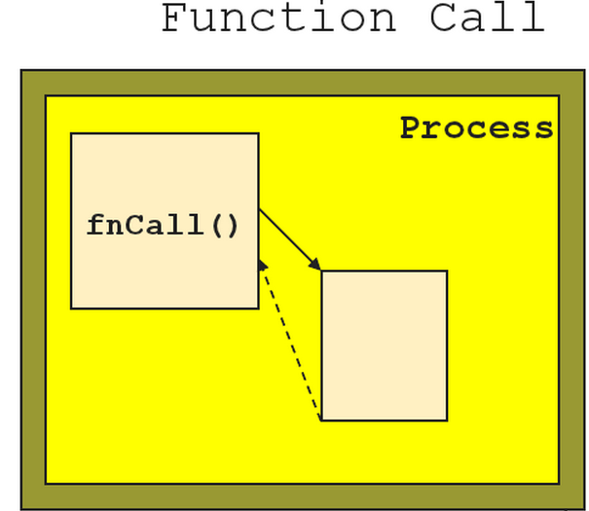
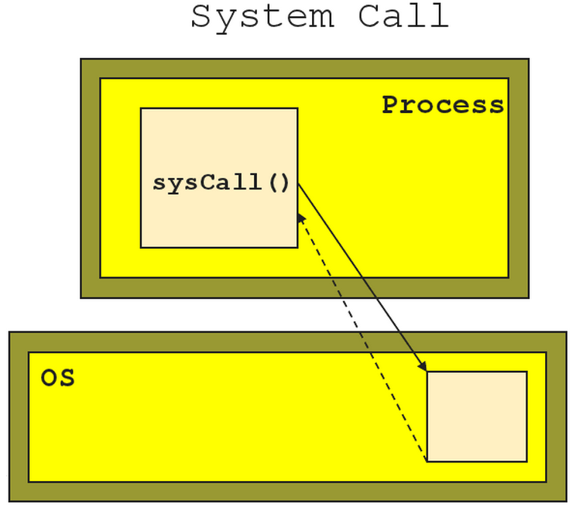
Function Call vs. System Call
Caller and callee are in the same process
Same “domain of trust”
Control is transferred from the untrusted user process to the trusted OS

Slide 10
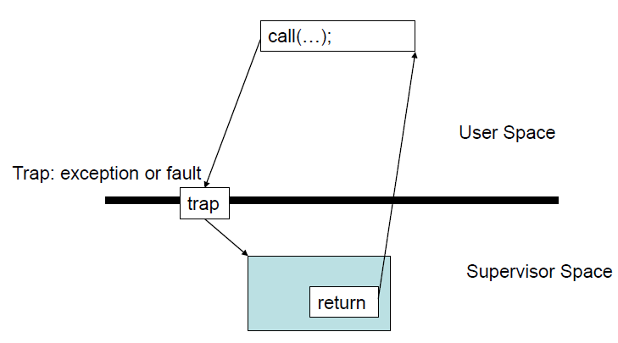
System Calls
When a system call is made the program being executed is interrupted and control is passed to the kernel
If operation is valid the kernel performs it

Slide 11
System Call Overhead
System calls are expensive and can hurt performance
The system must do many things
  Process is interrupted & computer saves its state
  OS takes control of the CPU
  OS performs requested action
  OS saves its state
  OS gives control of the CPU back to user process

Slide 12
Library Functions
Functions that are a part of standard C library
To avoid system call overhead use equivalent library functions
  getchar, putchar vs. read, write (for standard I/O)
  fopen, fclose vs. open, close (for file I/O), etc.
How do these functions perform privileged operations?
  They make system calls

Slide 13
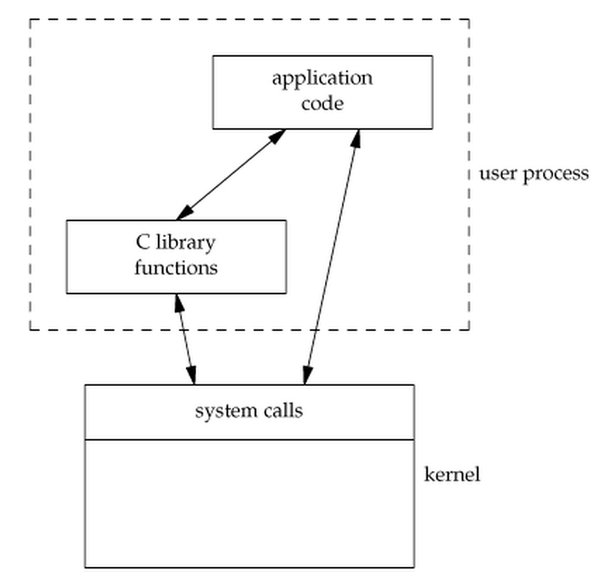
So What’s the Point?
Many library functions invoke system calls indirectly
So why use library calls?
Usually equivalent library functions make fewer system calls
non-frequent switches from user mode to kernel mode => less overhead

Slide 14
Unbuffered vs. Buffered I/O
Unbuffered
  Every byte is executed (read/written) by the kernel through a system call
Buffered
  collect as many bytes as possible (in a buffer) and read more than a single byte (into buffer) at a time and use one system call for a block of bytes
=> Buffered I/O decreases the number of read/write system calls and the corresponding overhead

Slide 15
Buffered I/O
Writing to a file:
  fwrite() copies outgoing data to a local buffer as long as it’s not full and returns to the caller immediately
  When buffer space is running out, fwrite() calls the write() system call to flush the buffer to make room
Reading from a file:
  fread() copies requested data from the local buffer to user's process as long as the buffer contains enough data
  When the buffer is empty, fread() calls the read() system call to fill the buffer with data and then copies data from the buffer

Slide 16
Lab 7
Write 2 versions of the cat program
  Version 1 (catb.c)
    Library functions: getchar and putchar for copying
  Version 2 (catu.c)
    System calls: read and write for copying
Use strace to compare the number of system calls issued by each version when
  Copying one file to another
  Copying a file to your terminal
Use time to measure how much faster one program is than the other

Slide 17
time and strace
time [options] command [arguments...]
Output:
  real 0m4.866s: elapsed time as read from a wall clock
  user 0m0.001s: the CPU time used by your process
  sys 0m0.021s: the CPU time used by the system on behalf of your process
strace: intercepts and prints out system calls to stderr or to an output file
  strace –o strace_output ./catb < test
  strace –o strace_output2 ./catu < test

Slide 18
Homework 7
Rewrite srot13 using system calls (srot13u)
srot13u should behave like srot13 except:
  If stdin is a regular file, it should initially allocate enough memory to hold all data in the file all at once
  It outputs a line with the number of comparisons performed
Functions you’ll need: read, write, and fstat (read the man pages)
Measure differences in performance between srot13 and srot13u using the time command
Estimate the number of comparisons as a function of the number of input lines provided to srot13u

